Slide 1


SPSC CANSKATE PARENT MEETING Important highlights
CANSKATE INFORMATION & REPORT CARDS – Where to find it
STORM DAYS
HEALTHY KIDS! ACITVE KIDS!
EVENTS
City Subsidy & Non Qualifier Fee
Program Specifics

Slide 2
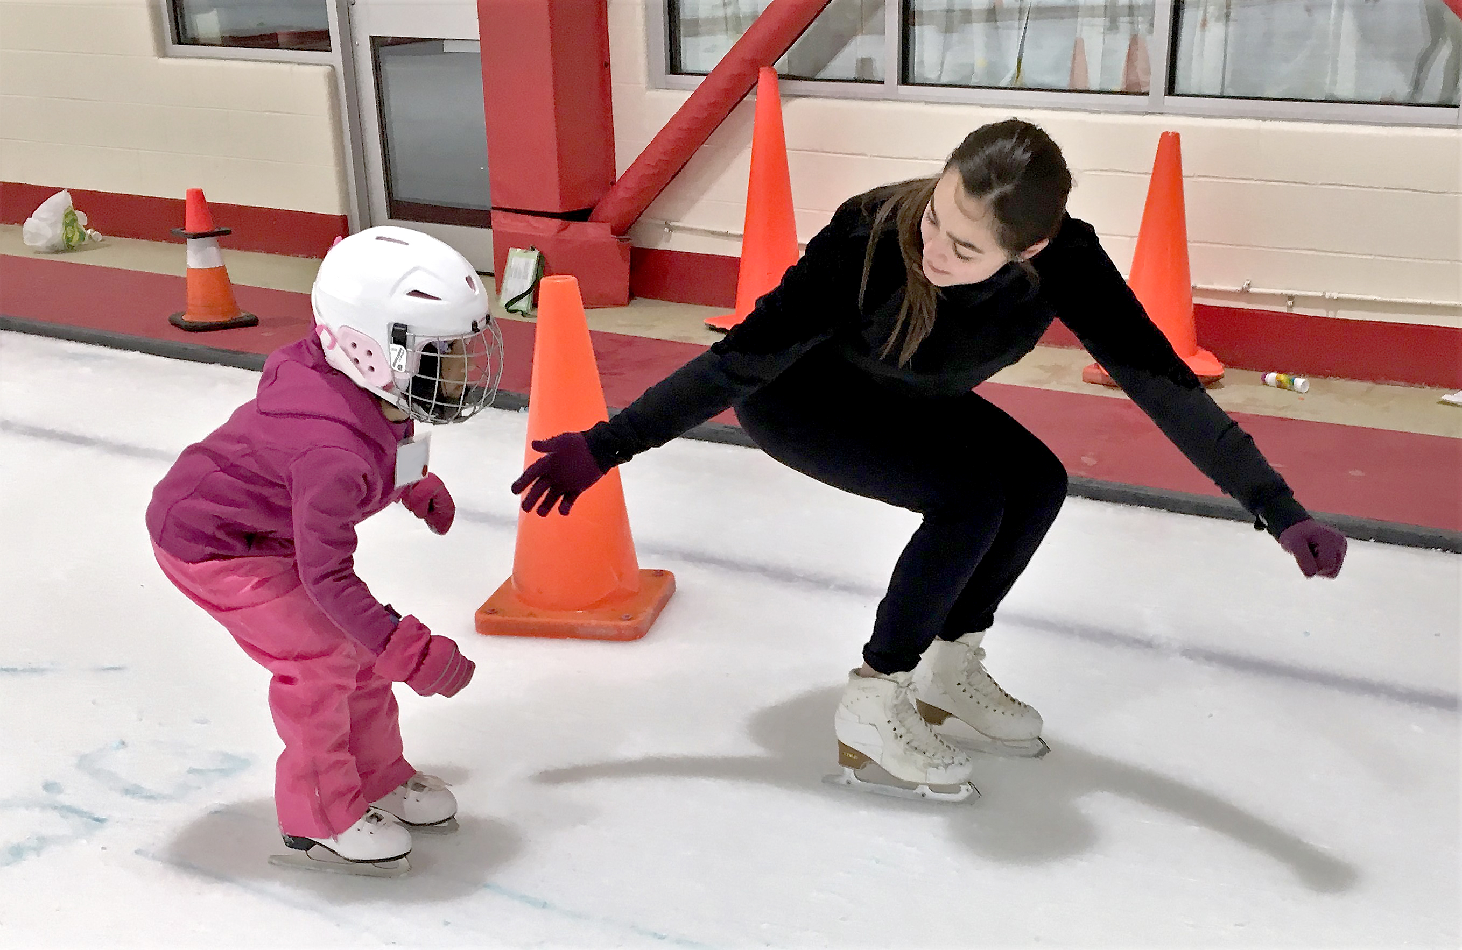
Welcome to Canskate
Sherwood Parkdale Skating Club is a member of Skate Canada and must abide by all by-laws set by Skate Canada, The PEI Section and our Club. There are links to all of these in our terms and conditions.
Please review our terms and conditions for club procedures

Slide 3
Our Canskate Team
Canskate Co-Ordinator – Jessica Godfrey
Coaching Team
Brielle Barrett
Brenley Bissett
Shelby Dyment
Grace Godfrey
Jessica Godfrey
Deonna King
Program Assistants
Junior, Intermediate and Senior Starskaters

Slide 4


Where to find things

Slide 5
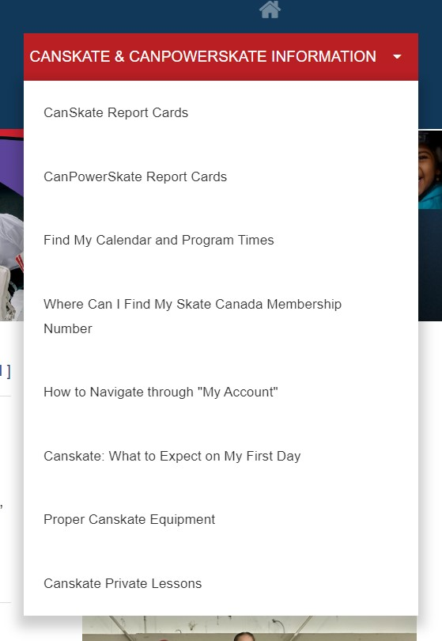
How to find things
Drop down menu
Where to find answers

Slide 6
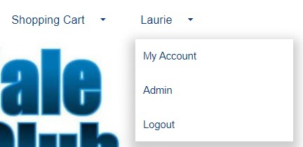
Your Account
Click on the drop down that reads “My Account”
Once in your account you can access your profiles
Update Contact Information
Review your participants and their evaluations or achievements
THE CALENDAR TAB while logged into your account shows all your registered skating times and events.
Invoice Tab for copies of all your registrations

Slide 7
City Subsidy
The club will need to confirm addresses of those that qualify for the city subsidy.
The subsidy covers the balance of the full program cost
Paying a subsidy non-qualifier fee
This amount is the same amount as what the city pays for those within their city limits
Where to address concerns

Slide 8

STORM WATCHES AND CLOSURES – in the event of storms or unforeseen closures, we will post on our website as well as send you an email. We normally only close if the facility is closed. Therefor if you see from a community posting that the arena is closed, then so are we. There is the off-chance if our administrator does not have power, they will not be able to email you. Please don’t call the arena as they are not part of our operation for detailed info.
Please keep your account contact info up to date. You can add a second email to your account if needed

Slide 9
Program Specifics
Your skaters name tag will have a colour indicating their group
This colour does NOT reflect what stage of canskate achievement they have
The groupings on the ice are to maintain coach ratio and put children together that are either at the same level or working on similar skills.
Skaters may get moved from time-to-time to another group for best practice
If they skate more than one day a week, they may have a different colour group on each day dependant on the balance of skaters on the ice for that day.
No matter which group a skater is in, they will ALWAYS work at their personal level.

Slide 10
PRIVATE LESSONS Option for skaters registered in a group program based on availability.
Canskate: private lessons may be arranged with the coach of your choosing as available. Lessons from our Group Canskate Coaches would need to take place during another session time. You can be on a non-canskate session for the length of your lesson only. You may also contact non-Canskate Group Coaches to have private lesson time during Canskate Sessions space permitting. Private lessons are based on availability of coaches and all payment arrangements are between you and the coach.

Slide 11
Healthy Kids! Active Kids! Fundraiser
Our Main Club Fundraiser
This is not mandatory however we are asking all Canskaters and Powerskaters to consider purchasing at least one item.
With continual rising costs we are doing everything we can not to raise registration fees and would rather you purchase food for your tables which can in turn raise funds to keep fees down for the club.
Returning partner “Mike’s Queen Street Meat Market”
If you are keen and you purchase more than 10 items, you will receive a credit on your personal account as well as helping the club overall.
Extra order forms are available. We will also email out a copy for printing or using digitally.

Slide 12
Canskate Events
Sunday, December 21st HOLIDAY PERFORMANCE
Canskaters are asked to register at no cost
Food Bank Drive Event
Regular Canskate Session on this Sunday are NOT pre-empted; classes will run as usual
Join us for this fun event where we will not only celebrate the season but the joy of skating!

Slide 13


We are always looking for volunteers
This can be during your scheduled skating time only or at special events or if you love our skating community, we always could use someone new on the board.
During your skating time we are looking for those that would be willing to assist with:
Handing out colouring sheets or other treats
Assisting coaches, for example: if they are trying to locate a parent
Monitoring the entrance/exit door so that it does not get congested with parents
Assist coaches (from the off-ice side of the door) getting skaters onto the ice
Special Events
Notices will go out for help regarding our Ice Gala and Merit Event.

Slide 14
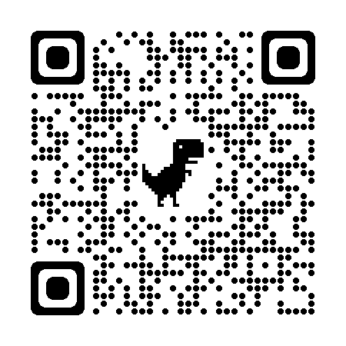
Club Apparel
We have a store available through Allstar Cresting
There are t-shirts, hoodies, outdoor jackets and more – Get in the spirit with quality merchandise. 10% goes to the club.
Here at the club, we also have mittens/gloves and a limited supply of skate guards for sale
Club competition/practice jackets are orderable through the club. Reach out to us at office@sherwoodparkdaleskatingclub.com if you are looking for an on-ice jacket. You can follow this link to our Allstar Store. This is also posted on our bulletin board.

Slide 15

Thank you

